Slide 1
Capstone Engagement
Assessment, Analysis, and Hardening of a Vulnerable System

Slide 2
Table of Contents
This document contains the following sections:
01
Network Topology
02
Red Team: Security Assessment
03
Blue Team: Log Analysis and Attack Characterization
Hardening: Proposed Alarms and Mitigation Strategies
04

Slide 3
Network Topology
3

Slide 4
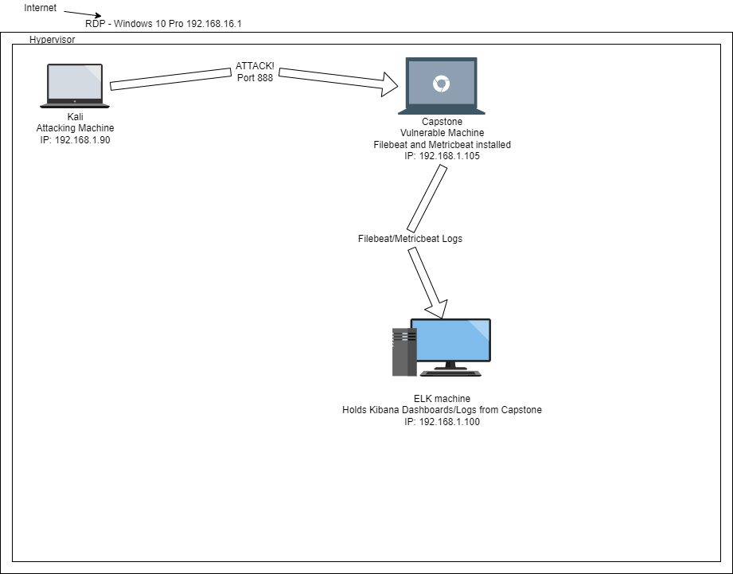
Network Topology
Network
Address Range: 192.168.16.1/30
Netmask: 255.255.255.0
Gateway:10.0.0.1
Machines
IPv4: 192.168.1.1
OS: Windows 10
Hostname: ML-RefVm-684427
IPv4: 192.168.1.90
OS: Linux
Hostname: Kali
IPv4: 192.168.1.105
OS: Linux
Hostname: Capstone
IPv4: 192.168.1.90
OS: Linux
Hostname: ELK machine

Slide 5

Red Team
Security Assessment
5

Slide 6
Recon: Describing the Target
Nmap identified the following hosts on the network:
Hostname | IP Address | Role on Network
Windows 10 Pro | 192.168.16.1 | Azure Clod RDP Host. Hypervisor.
Kali | 192.168.1.90 | Attacking Machine
Capstone | 192.168.1.105 | Vulnerable Machine
ELK machine | 192.168.1.100 | Kibana Dashboard collecting logs from Capstone machine

Slide 7
Vulnerability Assessment
The assessment uncovered the following critical vulnerabilities in the target:
Vulnerability | Description | Impact
Directory listing enabled (CWE-548: Exposure of Information Through Directory Listing) | A directory listing is inappropriately exposed, yielding potentially sensitive information to attackers. | Attacker was able to browse company folders and files to gain additional information.
Weak password security (CWE-916: Use of Password Hash With Insufficient Computational Effort) | The software generates a hash for a password, but it uses a scheme that does not provide a sufficient level of computational effort that would make password cracking attacks infeasible or expensive. | Weak password security allowed a bruteforce attack to gain unauthorized access to sensitive data
Unrestricted File Upload (CWE-434: Unrestricted Upload of File with Dangerous Type) | The software allows the attacker to upload or transfer files of dangerous types that can be automatically processed within the product's environment. | Unauthorized user can upload malicious files, like the reverse shell used in this attack

Slide 8
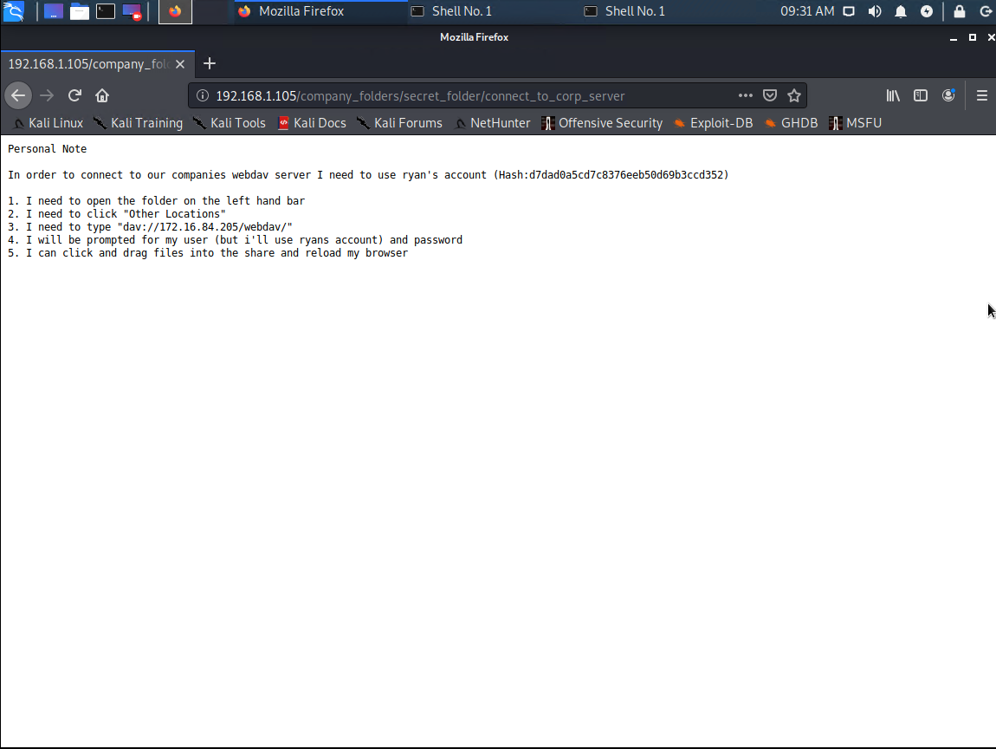
Exploitation: Directory Listing Enabled
01
02
03
Tools & Processes
Used browser to explore company folders, files.
Achievements
Used the directory listings to find the secret_folder with instructions on how to access the webdav server.

Slide 9
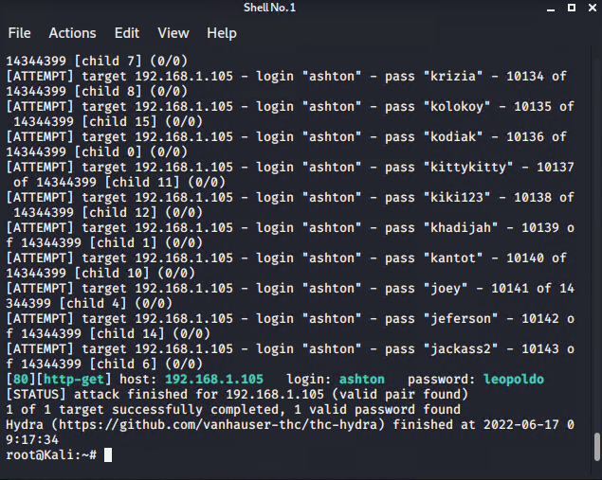
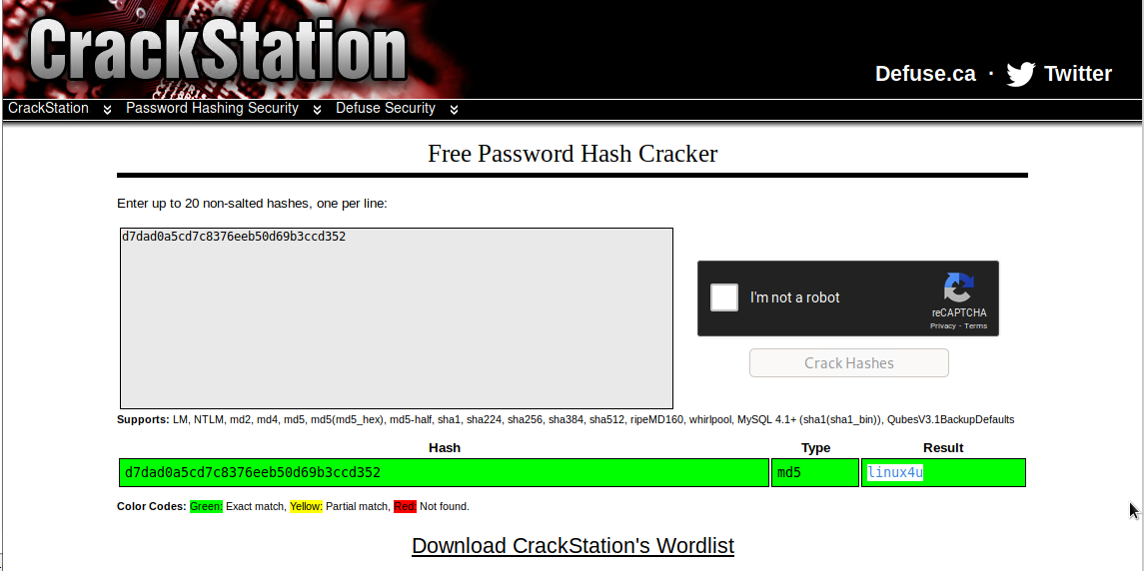
Exploitation: Weak Password Security
01
02
03
Tools & Processes
Used Hydra to crack Ashton's pasword to access the contents of the secret folder. Used CrackStation to crack Ryan's password and access the webdav server.
Achievements
Gained access to the secret folder and webdav server.

Slide 10
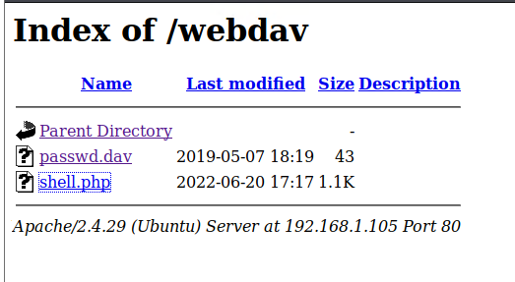
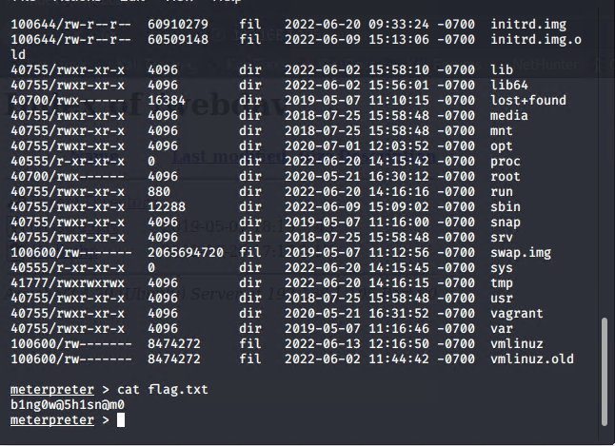
Exploitation: Unrestricted File Upload
01
02
03
Tools & Processes
Used msfvenom to create reverse shell payload and upload to webdav server via file explorer. Used Meterpreter to start reverse shell session.
Achievements
Granted user shell to capture the flag.

Slide 11

Blue Team
Log Analysis and Attack Characterization
11

Slide 12

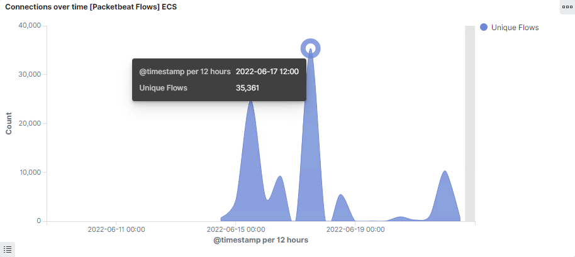
Analysis: Identifying the Port Scan
Answer the following questions in bullet points under the screenshot if space allows. Otherwise, add the answers to speaker notes.
What time did the port scan occur? 12pm 6/17/22
How many packets were sent, and from which IP? 35,361 from 192.168.1.8
What indicates that this was a port scan? Large volume of connections at from same machine

Slide 13
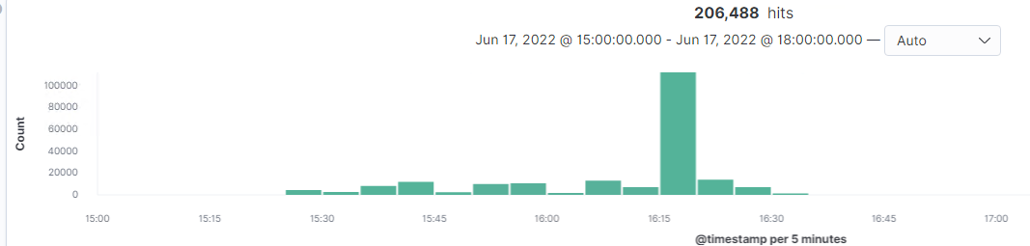
Analysis: Finding the Request for the Hidden Directory
Answer the following questions in bullet points under the screenshot if space allows. Otherwise, add the answers to speaker notes.
What time did the request occur? How many requests were made? 6/17/22 3pm. 112,502 total request
Which files were requested? What did they contain? The Connect to corporate server file was requested. It contained instructions and login credentials to connect to the webdav server

Slide 14
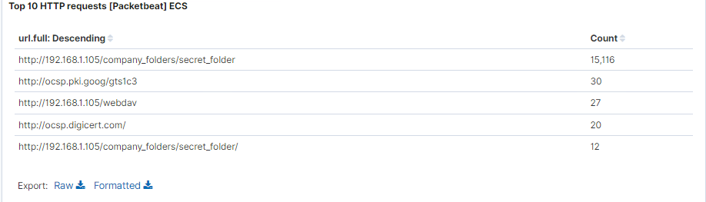
Analysis: Uncovering the Brute Force Attack
Answer the following questions in bullet points under the screenshot if space allows. Otherwise, add the answers to speaker notes.
How many requests were made in the attack? 15,116
How many requests had been made before the attacker discovered the password? 12

Slide 15
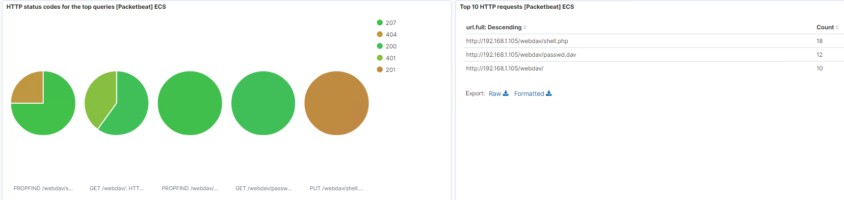
Analysis: Finding the WebDAV Connection
Answer the following questions in bullet points under the screenshot if space allows. Otherwise, add the answers to speaker notes.
How many requests were made to this directory? 105
Which files were requested? Passwd.dav & Shell.php

Slide 16
Blue Team
Proposed Alarms and Mitigation Strategies
16

Slide 17
Mitigation: Blocking the Port Scan
What kind of alarm can be set to detect future port scans?
Number of ports scanned per second per IP address.
What threshold would you set to activate this alarm?
Flag attempts to scan more than 15 ports per second per IP
What configurations can be set on the host to mitigate port scans?
Blocking port scans on the server via firewall
Describe the solution. If possible, provide required command lines.
Using Firewall to disable port scanning of network

Slide 18
Mitigation: Finding the Request for the Hidden Directory
What kind of alarm can be set to detect future unauthorized access?
An alarm can be set to trigger when unauthorized IPs attempt to view the hidden directory
What threshold would you set to activate this alarm?
I would create a whitelist of authorized IPs and activate the alarm when unauthorized IPs attempt access.
What configuration can be set on the host to block unwanted access?
Files should be password protected and not given read access to the public
Describe the solution. If possible, provide required command lines.
Locate the directory in Linux and chmod

Slide 19
Mitigation: Preventing Brute Force Attacks
What kind of alarm can be set to detect future brute force attacks?
An alarm highlighting the number of request being sent from unauthorized IPs
What threshold would you set to activate this alarm?
>5 attemps per second.
What configuration can be set on the host to block brute force attacks?
Multi factor authentication to add an additional layer of security to user logins.
Describe the solution. If possible, provide the required command line(s).
A multi factor software like Duo Security to authenticate end users

Slide 20
Mitigation: Detecting the WebDAV Connection
What kind of alarm can be set to detect future access to this directory?
Monitor access to webdav by unauthorized IPs
What threshold would you set to activate this alarm?
Alarm is triggered whenever access is attempted from unauthorized IPs
What configuration can be set on the host to control access?
Deny access from all non-whitelisted IPs
Describe the solution. If possible, provide the required command line(s).
Create a whitelist of approved IPs

Slide 21
Mitigation: Identifying Reverse Shell Uploads
What kind of alarm can be set to detect future file uploads?
An alarm that monitors 'put' request from unauthorized IPs
What threshold would you set to activate this alarm?
Alarm is triggered whenever a 'put' request is logged
What configuration can be set on the host to block file uploads?
Whitelist IPs that can read/write server files

